Slide 1


Game Engines 1
Hamiltonian Mechanics
Dr Bryan Duggan
DIT School of Computing
bryan.duggan@dit.ie
@ditcomputing
http://facebook.com/ditschoolofcomputing

Slide 2
Quaternion Quick Reference
Constructing
glm::quat q; \\ The identity
glm::angleAxis(thetaInDegrees, axis);
Convert a quaternion to a matrix:
glm::mat4_cast(orientation)
Convert a matrix to a quaternion:
glm::quat_cast(matrix)
Inverse of a quaternion
Negate x, y and z (for normal quats)
glm::quat qinv = glm::inverse(q);
Rotate a vector by a quaternion:
w = q * w * q⁻¹
Where q = quaternion and w = a pure quaternion made from the vector to be rotated (w = 0)

Slide 3
Convert a look vector to a quaternion
A quaternion stores a rotation not an orientation!
In 2d the angle 45 degrees must be understood relative to 0 degrees
Relative & absolute orientation
The same with a quaternion
To convert a vector to a look vector to a quaternion must be relative to a “basis” look vector
You can use any vector, but BGE uses:
[0 0 -1] Looking down the negative Z Axis

Slide 4
Basic Algorithm
Calculate
The axis of rotation
Recall A x B gives a vector C which is perpendicular to A & B:
Example: A = [0 1 0] B = [0 0 1]
A x B = [1 0 0]
The angle of rotation
θ = cos⁻¹(A.B / |A||B|)
Rotate the BASIS look vector by the quaternion
w = q * w * q⁻¹

Slide 5
Why are you messing up our minds with all this quaternion stuff!!!!
Quaternions are the universal way of representing rotation sequences in 3D
Use in all 3D libraries & game engines
Don’t suffer from Gimbal lock
Can be easily interpolated between
Are required to implement real 3D physics

Slide 6
Steering
Recall
a = f / m
v1 = v0 + at
p1 = p0 + vt
But how does force affect rotation?

Slide 7
Torque
The measure of the force applied to a member to produce rotational motion usually measured in meter/kg.
Torque is determined by multiplying the applied force by the distance from the pivot point to the point where the force is applied:
to = p x f
Torque = position (relative to centre of gravity) crossed with the force
Torque is a vector
The size of the vector gives the amount of torque
The direction of the torque gives the axis

Slide 8
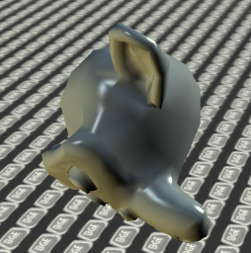
Angular velocity
The rate at which a spinning body, such as a planet, rotates. The Earth rotates at 15 degrees per hour, which is its angular velocity.
Given as a vector

Slide 9
Angular acceleration
Angular acceleration is the rate of change of angular velocity over time.
It is measured in radians per second squared (rad/s2), and is usually denoted by the Greek letter α.
A vector also

Slide 10
Inertia
The property of a body which resists change in its motion
Two kinds
Translational motion (mass)
Rotational motion (inertial tensor or moment of inertia)
Inertial tensor
Don’t worry about them it’s a math term
Basically it means a matrix
Describes how an objects mass is distributed around its shape
Generalization of scalars/vectors/matrix’s
Scalars are rank 0 tensor, vectors 1, matrix’s 2
Concerned with rank 2 tensors, for moment of inertia
Can also accurately simulate drag
You can approximate a complex shape with a simple one
Will anyone notice???

Slide 11
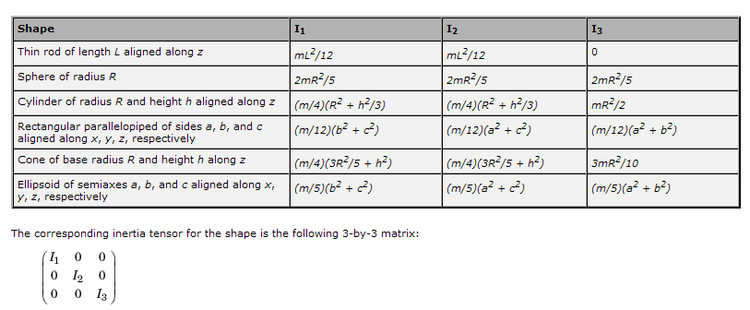
Calculating inertial tensors
Different algorithms for different geometric primitives
For example:

Slide 12
Equations of motion for rotation
Torque = position x force
to = p x f
Angular acceleration = torque * 1 / it
aa = torque * 1/it
Angular velocity = angular velocity + angular acceleration * t
Orientation = Orientation + (time/2) w Orientation
o = o + t/2 w o
Where w = pure quaternion of the angular velocity
Simple isnt it!

Slide 13
2 ways of adding force:
Add force at centre of mass of the object (doesn’t generate any torque)
Just update the force accumulator
Add force at a point on the object (may generate torque)
Update the force accumulator
AND update the torque accumulator

Slide 14
One last gotcha
You need to rotate the inertial tensor by the quaternion at each time step
I think!!!
Easiest thing is to convert the quaternion by a matrix
Multiply the inertial tensor by the matrix

Slide 15
Putting it all together… Steerable3DController
From GameComponent:
glm::vec3 position;
glm::vec3 look;
glm::vec3 up;
glm::vec3 right;
glm::vec3 scale;
glm::vec3 velocity;
glm::mat4 world;
glm::quat orientation;
Steerable3DController (subclass) adds:
float mass;
glm::vec3 velocity, force, acceleration;
glm::vec3 angularVelocity, angularAcceleration, torque;
glm::mat3 inertialTensor;

Slide 16
Adding force/torque
void Steerable3DController::AddForce(glm::vec3 force)
{
this->force += force;
}
void Steerable3DController::AddTorque(glm::vec3 torque)
{
this->torque += torque;
}
void Steerable3DController::AddForceAtPoint(glm::vec3 force, glm::vec3 point)
{
glm::vec3 to = glm::cross(force, point);
torque += to;
force += force;
}

Slide 17
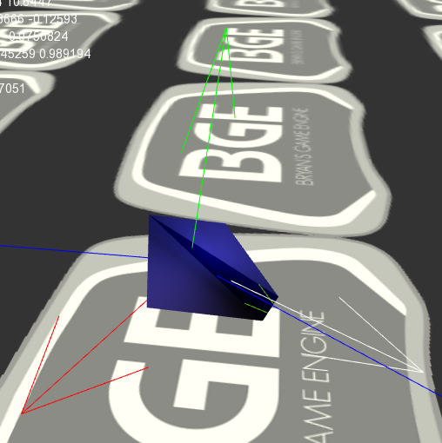
if (keyState[SDL_SCANCODE_SPACE])
{
AddForce(look * scale * timeDelta);
}
// Yaw
if (keyState[SDL_SCANCODE_J])
{
AddTorque(up * scale * timeDelta);
}
if (keyState[SDL_SCANCODE_L])
{
AddTorque(- up * scale * timeDelta);
}
//Pitch
if (keyState[SDL_SCANCODE_I])
{
AddTorque(right * scale * timeDelta);
}
if (keyState[SDL_SCANCODE_K])
{
AddTorque(- right * scale * timeDelta);
}
// Roll
if (keyState[SDL_SCANCODE_Y])
{
AddTorque(look * scale * timeDelta);
}
if (keyState[SDL_SCANCODE_H])
{
AddTorque(- look * scale * timeDelta);
}

Slide 18
Calculating the Inertial Tensor
void Steerable3DController::CalculateInertiaTensor() {
float width = model->boundingBox.max.x - model->boundingBox.min.x;
float height = model->boundingBox.max.y - model->boundingBox.min.y;
float depth = model->boundingBox.max.z - model->boundingBox.min.z;
inertialTensor[0][0] = (float) (mass * (pow(height, 2) + pow(depth, 2))) / 12.0f;
inertialTensor[1][1] = (float) (mass * (pow(width, 2) + pow(depth, 2))) / 12.0f;
inertialTensor[2][2] = (float) (mass * (pow(width, 2) + pow(height, 2))) / 12.0f;
}

Slide 19
Integration
// Do the Newtonian integration
acceleration = force / mass;
velocity += acceleration * timeDelta;
position += velocity * timeDelta;
// Normalise the velocity into the look
// Probably not necessary as we recalculate these anyway later
if (glm::length(velocity) > 0.0001f)
{
look = glm::normalize(velocity);
right = glm::cross(look, up);
velocity *= 0.99f;
}
// Do the Hamiltonian integration
angularAcceleration = torque * glm::inverse(inertialTensor);
angularVelocity = angularVelocity + angularAcceleration * timeDelta;
glm::quat w = glm::quat(0, angularVelocity.x, angularVelocity.y, angularVelocity.z);
orientation = orientation + ((w * (timeDelta / 2.0f)) * orientation);
orientation = glm::normalize(orientation);
// Reset the accumulators
torque = glm::vec3(0);
force = glm::vec3(0);

Slide 20
Implicit Integration
We are doing explicit (forward) euler integration so far in our modeling.
If stability is an issue you can use implicit integration:
Runge Kutta technique
Precise integration technique
Sample several times for each time step.
t = 0, t = .25, t = .5, t = .75 to find value at t = 1
Provides very accurate results
http://mathworld.wolfram.com/Runge-KuttaMethod.html
http://www.mech.gla.ac.uk/~peterg/software/MTT/examples/Simulation_rep/node89.html

